Slide 1
Forces and Uniform Circular Motion
Physics
Unit 2
Notes:
Physics Unit 2

Slide 2
This Slideshow was developed to accompany the textbook
  OpenStax Physics
    Available for free at https://openstaxcollege.org/textbooks/college-physics
  By OpenStax College and Rice University
  2013 edition
Some examples and diagrams are taken from the OpenStax Physics and Cutnell & Johnson Physics 6th ed.
Slides created by
Richard Wright, Andrews Academy
rwright@andrews.edu

Slide 3
02-01 Newton’s Laws of Motion
In this lesson you will…
• Understand the definition of force.
• Define mass and inertia.
• Understand Newton's first law of motion.
• Define net force, external force, and system.
• Understand Newton’s second law of motion.
• Understand Newton's third law of motion.

Slide 4
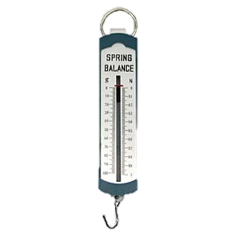
02-01 Newton’s Laws of Motion
Kinematics
  How things move
Dynamics
  Why things move
Force
  A push or a pull
  Is a vector
  Unit: Newton (N)
  Measured by a spring scale

Slide 5
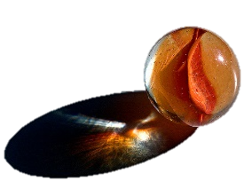
02-01 Newton’s Laws of Motion
Place a marble on your desk so that it is at rest (not moving).
Observe the marble for a minute. What happens to it?
Without applying a force to the marble, make it move. Remember gravity is a force, so tipping the desk is the same as applying a force. Were you able to move the marble?
Roll the marble across your desk at a moderate speed so that it has no sidewise spin. Describe the path the marble took.
Without a sidewise spin, tipping the desk, or applying a force, can you make the marble take a curved path?
Notes:
2. Nothing
3. No
4. Straight
5. No

Slide 6
02-01 Newton’s Laws of Motion
Newton’s First Law of Motion
A body at rest remains at rest, or, if in motion, remains in motion at a constant velocity unless acted on by a net external force.
Inertia
  Property of objects to remain in constant motion or rest.
  Mass is a measure of inertia
  Watch Eureka! 01
  Watch Eureka! 02
Notes:
Example: Ice hockey, puck sits until someone hits it. Then it goes straight.

Slide 7
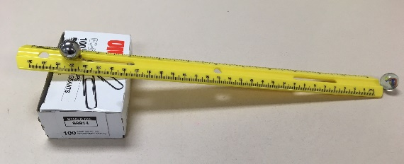
02-01 Newton’s Laws of Motion
Make a ramp using the grooved ruler and a book.
Place a glass marble on your desk at the end of the ramp.
Release the other glass marble from the top of the ramp so that it rolls and hits the marble on the desk. Observe the velocity of the marble that was on the desk.
Place a glass marble on the desk at the end of the ramp.
Release the metal marble from the top of the ramp so that it rolls and hits the metal marble on the desk. Observe the velocity of the metal marble.
Which marble on the desk (1st or 2nd) had a larger force applied to it?
Which marble had the larger final velocity?
What was the marble’s initial velocity in both cases?
Define acceleration.
Which marble had the larger acceleration?
What is the relationship between force and acceleration?
Notes:
6. 2nd
7. 2nd
8. 0
9. $a=\frac{Δv}{Δt}$
10. 2nd
11. Bigger force = bigger acceleration

Slide 8
02-01 Newton’s Laws of Motion
Place a glass marble on your desk at the end of the ramp.
Release the other glass marble from the top of the ramp so that it rolls and hits the marble on the desk. Observe the velocity of the marble that was on the desk.
Place a metal marble on the desk at the end of the ramp.
Release the glass marble from the top of the ramp so that it rolls and hits the metal marble on the desk. Observe the velocity of the metal marble.
Which marble on the desk (glass or metal) had a larger force applied to it?
Which marble had the larger final velocity?
Which marble had the larger acceleration?
Which marble had more mass?
What is the relationship between mass and acceleration?
Notes:
5. Same
6. Glass
7. Glass
8. Metal
9. Bigger mass = smaller acceleration

Slide 9

02-01 Newton’s Laws of Motion
Newton’s Second Law of Motion
Acceleration of a system is directly proportional to and in the same direction as the net force acting on the system, and inversely proportional to its mass.
$$F_{net}=ma$$
Net force is the vector sum of all the forces.
Watch Eureka! 03
Watch Eureka! 04
Watch Eureka! 05

Slide 10
02-01 Newton’s Laws of Motion
Take two spring scales and hook their ends together. Lay them horizontally on the desk.
Gently pull on one spring scale so it reads 4 N.
What do the scales read for the force?
Apply 3-N force. What do the scales read?
With the scales hooked together, try to pull only one scale so that the other one does not experience a force. Were you successful, explain.
Notes:
3. 4 N, 4 N
4. 3 N, 3 N
5. No (there is some friction involved in the spring scales and that can cause unequal force readings)

Slide 11
02-01 Newton’s Laws of Motion
Newton’s Third Law of Motion
Whenever one body exerts a force on a second body, the first body experiences a force that is equal in magnitude and opposite in direction to the force that it exerts.
Every force has an equal and opposite reaction force.
You push down on your chair, so the chair pushed back up on you.

Slide 12
02-01 Newton’s Laws of Motion
A football player named Al is blocking a player on the other team named Bob. Al applies a 1500 N force on Bob. If Bob's mass is 100 kg, what is his acceleration?
What is the size of the force on Al?
If Al's mass is 75 kg, what is his acceleration?
Notes:
$$F=ma$$
$$1500 N=\left(100 kg\right)a→a=15 m/s^{2}$$
1500 N (Newton’s 3rd Law)
$$F=ma$$
$$1500 N=\left(75 kg\right)a→a=20 m/s^{2}$$

Slide 13

02-01 Newton’s Laws of Motion
A 0.046 kg golf ball hit by a driver can accelerate from rest to 67 m/s in 1 ms while the driver is in contact with the ball. How much average force does the golf ball experience?
Notes:
$$v=at+v_{0}$$
$$67\frac{m}{s}=a\left(1×10^{−3} s\right)+0$$
$$67000\frac{m}{s^{2}}=a$$
$$F=ma$$
$$F=\left(0.046 kg\right)\left(67000\frac{m}{s^{2}}\right)$$
$$F=3082 N$$

Slide 14
02-01 Newton’s Laws of Motion
Force yourself to do these problems
Read 4.5, 4.6, 6.5

Slide 15
02-02 Weight and Gravity
In this lesson you will…
• Define normal force.
• Apply Newton's laws of motion to solve problems involving a variety of forces.
• Use trigonometric identities to resolve weight into components.
• Understand and apply a problem-solving procedure to solve problems using Newton's laws of motion.
• Explain Earth’s gravitational force.

Slide 16

02-02 Weight and Gravity
Weight
  Measure of force of gravity
  $F=ma$
  Objects near earth accelerate downward at 9.80 m/s²
  $w=mg$
  Unit: N
  Depends on local gravity
Mass
  Not a force
  Measure of inertia or amount of matter
  Unit: kg
  Constant
  Watch Eureka! 6

Slide 17

02-02 Weight and Gravity
Every particle in the universe exerts a force on every other particle
$$F_{g}=G\frac{mM}{r^{2}}$$
$G = 6.673×{10}^{−11} N m2/kg2$
m and M are the masses of the particles
r = distance between the particles (centers of objects)
Notes:
G is the universal gravitational constant – measured by Henry Cavendish using a very sensitive balance 100 years after Newton proposed the law

Slide 18
02-02 Weight and Gravity
For bodies
Using calculus – apply universal gravitation for bodies
Estimate (quite precisely)
  Assume bodies are particles based at their center of mass
  For spheres assume they are particles located at the center

Slide 19

02-02 Weight and Gravity
What is the gravitational attraction between a 75-kg boy (165 lbs) and the 50-kg girl (110 lbs) seated 1 m away in the next desk?
F_{g} = $2.5×{10}^{−7}$ N
  = $2.6×{10}^{−8}$ lbs of force
Notes:
$$m_{1}=75 kg; m_{2}=50 kg; r=1 m$$
$$F_{g}=\frac{GMm}{r^{2}}$$
$$F=\frac{6.67×{10}^{−11}\frac{Nm^{2}}{kg^{2}}\left(75 kg\right)\left(50 kg\right)}{{\left(1 m\right)}^{2}}=2.5×{10}^{−7} N$$

Slide 20
02-02 Weight and Gravity
Weight is Gravitational Force the earth exerts on an object
Unit: Newton (N)
Remember!!!
  Weight is a Force
Watch Eureka 7
Notes:
Eureka #7

Slide 21

02-02 Weight and Gravity
Weight
$$W=G\frac{mM}{r^{2}}$$
$$W=mg$$
$$g=G\frac{M}{r^{2}}$$
r is usually R_{E}
  So g = 9.80 m/s²

Slide 22
02-02 Weight and Gravity
The gravitational pull from the moon and sun causes tides
  Water is pulled in the direction of the moon and sun
Gravitational pull from satellites causes the main body to move slightly
  Moon causes earth to move
  Planets cause sun/star to move

Slide 23

02-02 Weight and Gravity
Problems-Solving Strategy
Identify the principles involved and draw a picture
List your knowns and Draw a free-body diagram
Apply $F_{net}=ma$
Check your answer for reasonableness

Slide 24
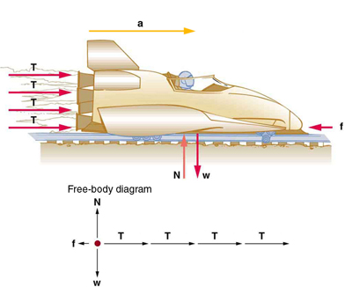
02-02 Weight and Gravity
Free-body diagram
  Draw only forces acting on the object
  Represent the forces with vector arrows

Slide 25
02-02 Weight and Gravity
When two objects touch there is often a force
Normal Force
  Perpendicular component of the contact force between two objects
F_{N}

Slide 26
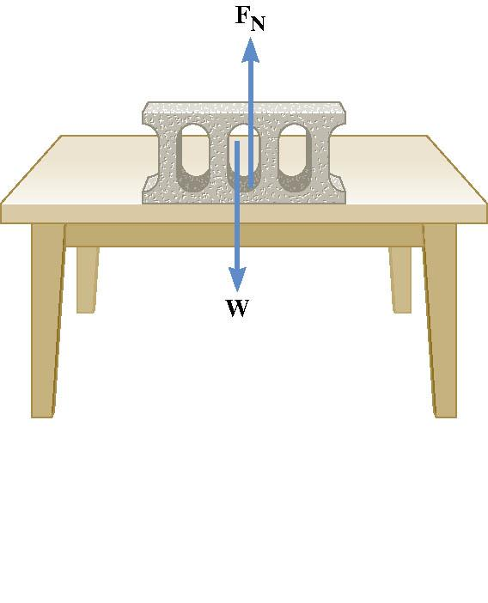
02-02 Weight and Gravity
Weight pushes down
So the table pushes up
  Called Normal force
  Newton’s 3rd Law
Normal force doesn’t always = weight
Draw a freebody diagram to find equation

Slide 27
02-02 Weight and Gravity
Hang the mass from the spring scale. The scale will measure the force applied to hold the mass in place. This is the weight.
What is the weight of your mass?
Carefully watch the spring scale as you quickly move the scale upwards. What happens to the weight?
Carefully watch the spring scale as you quickly move the scale downwards. What happens to the weight?
The other weights are called apparent weight and is what you feel as the net force pulling you down. An upward acceleration produces a _______________________ apparent weight. A downward acceleration produces a ______________________ apparent weight.
When a problem asks for apparent weight, find the normal force
Notes:
3. More
4. Less
5. larger; smaller

Slide 28
02-02 Weight and Gravity
A lady is weighing some bananas in a grocery store when the floor collapses. If the bananas mass is 2 kg and the floor is accelerating at -2.25 m/s², what is the apparent weight (normal force) of the bananas?
F_{N} = 15.1 N
Notes:
Draw freebody diagram and solve
$$F_{net}=F_{N}−w=ma$$
$$F_{N}−\left(2 kg\right)\left(9.8\frac{m}{s^{2}}\right)=\left(2 kg\right)\left(−2.25\frac{m}{s^{2}}\right)$$
$$F_{N}=15.1 N$$

Slide 29
02-02 Weight and Gravity
A box is sitting on a ramp angled at 20°. If the box weighs 50 N, what is the normal force on the box?
47 N
F_{N}
20°
20°
w
Notes:
$$w_{⊥}=w⋅\cos{20°}=47 N$$
$$F_{N}−w_{⊥}=ma=0$$
$$F_{N}=w_{⊥}=47 N$$

Slide 30
02-02 Weight and Gravity
Just like gravity, these problems are attractive.
Read 5.1

Slide 31
02-03 Friction
In this lesson you will…
• Discuss the general characteristics of friction.
• Describe the various types of friction.
• Calculate the magnitude of static and kinetic friction.

Slide 32
02-03 Friction
Do the lab in your worksheet
How is friction reduced in car engines? Hovercraft?
Notes:
Oil to make it smoother
No mass on ground, so no normal force

Slide 33
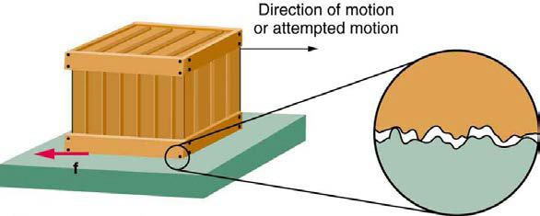
02-03 Friction
Normal force – perpendicular to surface
Friction force – parallel to surface, and opposes motion
Comes from rough surface
Not well understood

Slide 34
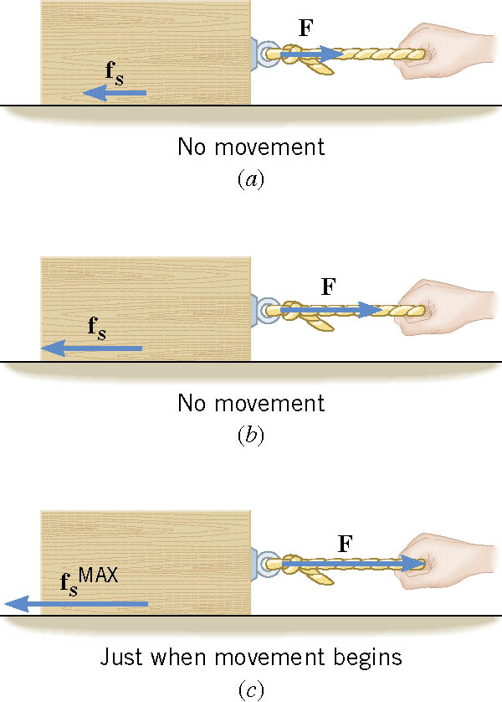
02-03 Friction
Static Friction
  Keeps things from moving.
  Cancels out applied force until the applied force gets too big.
  Depends on force pushing down and roughness of surface

Slide 35

02-03 Friction
Static Friction
    Depends on force pushing down and roughness of surface
  $f_{S}≤μ_{S}F_{N}$
  More pushing down (F_{N}), more friction
  $μ_{S}$ is coefficient of static friction (0.01 to 1.5)

Slide 36

02-03 Friction
Kinetic Friction
  Once motion happens
  $f_{k}=μ_{k}F_{N}$
  $f_{k}$ is usually less than $f_{s}$

Slide 37
02-03 Friction
A car skids to a stop after initially going 30.0 m/s. μ_{k} = 0.800. How far does the car go before stopping?
57.3 m
W
f_{k}
F_{N}
Notes:
$$y: F_{N}=W=mg$$
$$x: f_{k}=μ_{k}F_{N}=μ_{k}mg$$
$$F=ma$$
$$μ_{k}mg=ma→ μ_{k}g=a$$
$$v^{2}=v_{0}^{2}+2ax→ v^{2}=v_{0}^{2}+2μ_{k}gx$$
$$0={\left(30.0\frac{m}{s}\right)}^{2}+2\left(0.800\right)\left(−9.80\frac{m}{s^{2}}\right)x$$
$$−900 {\left(\frac{m}{s}\right)}^{2}=\left(15.7\frac{m}{s^{2}}\right)x → x=57.3 m$$

Slide 38





02-03 Friction
A 65-kg skier is coasting downhill on a 15° slope. Assuming the coefficient of friction is that of waxed wood on snow, what is the skier’s acceleration?
$1.59 m/s^{2}$ downhill
$$F_{N}$$
$$f$$
$$15°$$
$$w$$
Notes:
Perpendicular direction:
$$F_{N}−w\cos{15°}=ma$$
$$F_{N}−mg\cos{15°}=m\left(0\right)$$
$$F_{N}−\left(65 kg\right)\left(9.8\frac{m}{s^{2}}\right)\cos{15°}=0$$
$$F_{N}=615.2948 N$$
parallel direction:
$$f−w\sin{15°}=ma$$
$$μ_{k}F_{N}−mg\sin{15°}=ma$$
$$\left(0.1\right)\left(615.2948 N\right)−\left(65 kg\right)\left(9.8\frac{m}{s^{2}}\right)\sin{15°}=\left(65 kg\right)a$$
$$−103.338 N=\left(65 kg\right)a$$
$$−1.59\frac{m}{s^{2}}=a$$

Slide 39
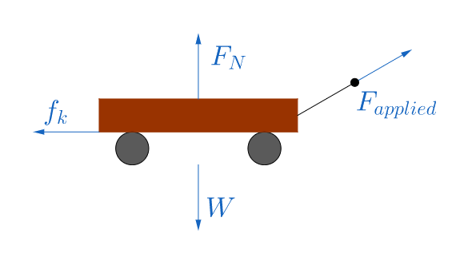
02-03 Friction
While hauling firewood to the house, you pull a 100-kg wood-filled wagon across level ground at a constant velocity. You pull the handle with a force of 230 N at 30° above the horizontal. What is the coefficient of friction between the wagon and the ground?
Notes:
$$y:F_{N}−W+230 N sin 30°=ma$$
$$F_{N}−\left(100 kg\right)\left(9.8\frac{m}{s^{2}}\right)+115 N=\left(100 kg\right)\left(0\right)$$
$$F_{N}=865 N$$
$$x:230 N cos 30°−f_{k}=ma$$
$$199.1858 N−μ_{k}F_{N}=ma$$
$$199.1858 N−μ_{k}\left(865 N\right)=(100 kg)(0)$$
$$199.1858 N=\left(865 N\right)μ_{k}$$
$$μ_{k}=0.230$$

Slide 40
02-03 Friction
Don’t let these problems cause friction between us
Read 4.5, 5.2, 4.7

Slide 41
02-04 Tension, Hooke's Law, Drag, and Equilibrium
In this lesson you will…
• Define tension force.
• Apply Newton's laws of motion to solve problems involving a variety of forces.
• Express mathematically the drag force.
• Discuss the applications of drag force.
• Define terminal velocity.
• Determine the terminal velocity given mass.
• Apply problem-solving techniques to solve for quantities in more complex systems of forces.

Slide 42
02-04 Tension, Hooke's Law, Drag, and Equilibrium
Do the lab on your worksheet

Slide 43

02-04 Tension, Hooke's Law, Drag, and Equilibrium
Hooke's Law
  For springs or forces that deform (change shape)
  For small deformations (no permanent change)
  $F_{S}=kΔx$
    $k=$ spring constant and is unique to each spring
    $Δx=$ the distance the spring is stretched/compressed
  Hooke's Law is the reason we can use a spring scale to measure force

Slide 44
02-04 Tension, Hooke's Law, Drag, and Equilibrium
Tension
  Pulling force from rope, chain, etc.
  Everywhere the rope connects to something, there is an identical tension

Slide 45

02-04 Tension, Hooke's Law, Drag, and Equilibrium
Drag
  Resistive force from moving through a fluid
  Size depends on area, speed, and properties of the fluid
For large objects
  $F_{D}=\frac{1}{2}CρAv^{2}$
  $C$ = drag coefficient
  $ρ$ = density of fluid
  $A$ = cross-sectional area of object
  $v$ = speed of object relative to the fluid
Notes:
Fluids are liquids and gases
Area – think of your have outside of car window
C = drag coefficient measured by experiment, table 5.2

Slide 46

02-04 Tension, Hooke's Law, Drag, and Equilibrium
Equilibrium
  No acceleration
  $F_{net}=ma$
  $F_{net}=0$

Slide 47

02-04 Tension, Hooke's Law, Drag, and Equilibrium
Find the terminal velocity of a falling mouse in air ($A=0.004 m^{2}, m=0.02 kg, C=0.5$) and a falling human falling flat ($A=0.7 m^{2}, m=85 kg, C=1.0$). The density of air is $1.21 kg/m^{3}$.
Mouse: 12.7 m/s
Human: 44.4 m/s
Notes:
$$F_{D}−w=0$$
$$\frac{1}{2}CρAv^{2}=mg$$
$$v=\sqrt{\frac{2mg}{ρCA}}$$
Mouse: $v=\sqrt{\frac{2\left(0.02 kg\right)\left(9.8\frac{m}{s^{2}}\right)}{\left(1.21\frac{kg}{m^{3}}\right)\left(0.5\right)\left(0.004 m^{2}\right)}}=12.7\frac{m}{s}$
Human: $v=\sqrt{\frac{2\left(85 kg\right)\left(9.8\frac{m}{s^{2}}\right)}{\left(1.21\frac{kg}{m^{3}}\right)\left(1.0\right)\left(0.7 m^{2}\right)}}=44.4\frac{m}{s}$
Mice bounce after big falls, but humans break

Slide 48
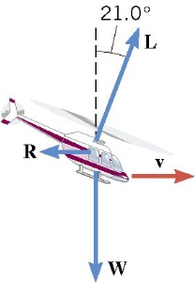
02-04 Tension, Hooke's Law, Drag, and Equilibrium
The helicopter in the drawing is moving horizontally to the right at a constant velocity. The weight of the helicopter is 53,800 N. The lift force L generated by the rotating blade makes an angle of 21.0° with respect to the vertical. What is the magnitude of the lift force?
57600 N
Notes:
y-components
$$L cos 21.0°−W=ma$$
$$L\cos{21.0°}−53800 N=0$$
$$L\cos{21.0°}=53800 N$$
$$L=57600 N$$

Slide 49

02-04 Tension, Hooke's Law, Drag, and Equilibrium
A stoplight is suspended by two cables over a street. Weight of the light is 110 N and the cables make a 122° angle with each side of the light. Find the tension in each cable.
104 N
T₁
T₂
122°
w
Notes:
$$Solve on board by making a table$$
$$F_{x}: T_{2}\cos{32°}−T_{1}\cos{32°}=0$$
$$T_{2}\left(.8480\right)−T_{1}\left(.8480\right)=0$$
$$T_{1}=T_{2}$$
$$F_{y}:−w+T_{1}\sin{32°}+T_{2}\sin{32°}=0$$
$$−110 N+T_{1}\left(.5299\right)+T_{2}\left(.5299\right)=0$$
$$−110 N+1.0598T_{1}=0$$
$$1.0598 T_{1}=110 N$$
$$T_{1}=T_{2}=103.8 N$$

Slide 50
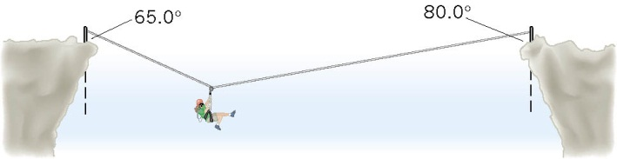
02-04 Tension, Hooke's Law, Drag, and Equilibrium
A mountain climber, in the process of crossing between two cliffs by a rope, pauses to rest. She weighs 535 N. Find the tensions in the rope to the left and to the right of the mountain climber.
Notes:
x-direction
$$−T_{1}\sin{65°}+T_{2}\sin{80°}=ma=0$$
$$T_{2}=0.920289T_{1}$$
y-direction
$$T_{1}\cos{65°}+T_{2}\cos{80°}−w=ma=0$$
$$T_{1}\cos{65°}+\left(0.9202889T_{1}\right)\cos{80°}−535 N=0$$
$$0.582424777T_{1}=535 N$$
$$T_{1}=919 N$$
$$T_{2}=845 N$$

Slide 51
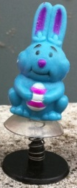
02-04 Tension, Hooke's Law, Drag, and Equilibrium
A 10-g toy plastic bunny is connected to its base by a spring. The spring is compressed and a suction cup on the bunny holds it to the base so that the bunny doesn't move. If the spring is compressed 3 cm and has a constant of 330 N/m, how much force must the suction cup provide?
Notes:
$$F_{S}−w−F_{cup}=ma=0$$
$$kx−mg−F_{cup}=0$$
$$\left(330\frac{N}{m}\right)\left(0.03 m\right)−\left(0.010 kg\right)\left(9.8\frac{m}{s^{2}}\right)−F_{cup}=0$$
$$F_{cup}=9.8 N$$

Slide 52
02-04 Tension, Hooke's Law, Drag, and Equilibrium
The tension is mounting… I can’t wait to see what’s next!
Read 4.8

Slide 53
02-05 Nonequilibrium and Fundamental Forces
In this lesson you will…
• Understand the four basic forces that underlie the processes in nature.

Slide 54
02-05 Nonequilibrium and Fundamental Forces
Four Basic Forces
  All forces are made up of only 4 forces
  Gravitational - gravity
  Electromagnetic – static electricity, magnetism
  Weak Nuclear - radioactivity
  Strong Nuclear – keeps nucleus of atoms together

Slide 55
02-05 Nonequilibrium and Fundamental Forces
All occur because particles with that force property play catch with a different particle
  Electromagnetic uses photons
  Scientists are trying to combine all forces together in Grand Unified Theory
  Have combined electric, magnetic, weak nuclear
Gravity is the weakest
  We feel it because the electromagnetic cancels out over large areas
Nuclear forces are strong but only over short distance
Notes:
Close on combining gravitational too

Slide 56
02-05 Nonequilibrium and Fundamental Forces
A 1380-kg car is moving due east with an initial speed of 27.0 m/s. After 8.00 s the car has slowed down to 17.0 m/s. Find the magnitude and direction of the net force that produces the deceleration.
Notes:
Use kinematics to find a
$$v_{0}=27.0\frac{m}{s}, t=8.00 s, v=17.0\frac{m}{s}, a= ?$$
$$v=at+v_{0}$$
$$17\frac{m}{s}=a\left(8 s\right)+27\frac{m}{s}$$
$$a=−1.25\frac{m}{s^{2}}$$
Use Newton’s 2nd Law
$$F=ma$$
$$F=\left(1380 kg\right)\left(−1.25\frac{m}{s^{2}}\right)=−1725 N$$
1725 N West

Slide 57
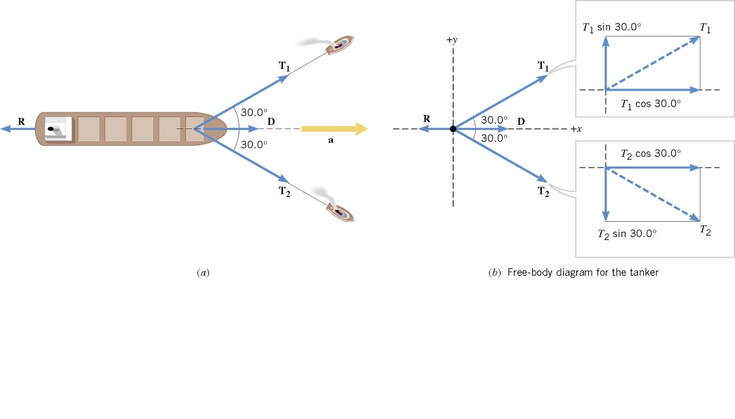

02-05 Nonequilibrium and Fundamental Forces
A supertanker of mass $m=1.50×{10}^{8}$ kg is being towed by two tugboats, as in the picture. The tensions in the towing cables apply the forces $T_{1}$ and $T_{2}$ at equal angles of 30.0° with respect to the tanker's axis. In addition the tanker's engines produce a forward drive force D, whose magnitude is $D=75.0×{10}^{3}$ N. Moreover, the water applies an opposing force R, whose magnitude is $R=40.0×{10}^{3}$ N. The tanker moves forward with an acceleration of $2.00×{10}^{−3}$ m/s². Find the magnitudes of the tensions $T_{1}$ and $T_{2}$.
Notes:
$$F_{net}=ma$$
$$y:T_{1}\sin{30°}−T_{2}\sin{30°}=ma=0$$
$$T_{1}=T_{2}$$
$$x:T_{1}\cos{30°}+T_{2}\cos{30°}+D−R=ma$$
$$T_{1}\left(\frac{\sqrt{3}}{2}\right)+T_{1}\left(\frac{\sqrt{3}}{2}\right)+75×{10}^{3} N−40.0×{10}^{3} N=\left(1.50×{10}^{8} kg\right)\left(2.00×{10}^{−3}\frac{m}{s^{2}}\right)$$
$$\sqrt{3}T_{1}=2.65×{10}^{5} N$$
$$T_{1}=T_{2}=1.53×{10}^{5} N$$

Slide 58
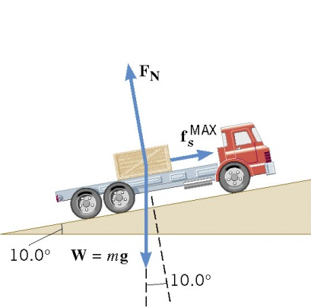

02-05 Nonequilibrium and Fundamental Forces
A flatbed truck is carrying a crate up a 10.0° hill as in the picture. The coefficient of the static friction between the truck bed and the crate is $μ_{s}=0.350$. Find the maximum acceleration that the truck can attain before the crate begins to slip backward relative to the truck.
Notes:
$$F_{net}=ma$$
$$y:F_{N}−w\cos{10°}=ma=0$$
$$F_{N}=mg\cos{10°}$$
$$x:f_{s}−w\sin{10°}=ma$$
$$μ_{s}F_{N}−mg\sin{10°}=ma$$
$$0.350\left(mg\cos{10°}\right)−mg\sin{10°}=ma$$
$$1.68\frac{m}{s^{2}}=a$$

Slide 59
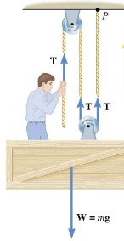
02-05 Nonequilibrium and Fundamental Forces
A window washer on a scaffold is hoisting the scaffold up the side of a building by pulling downward on a rope, as in the picture. The magnitude of the pulling force is 540 N, and the combined mass of the worker and the scaffold is 155 kg. Find the upward acceleration of the unit.
Notes:
$$3T−w=ma$$
$$3\left(540 N\right)−\left(155 kg\right)\left(9.8\frac{m}{s^{2}}\right)=\left(155 kg\right)a$$
$$0.65\frac{m}{s^{2}}=a$$

Slide 60
02-05 Nonequilibrium and Fundamental Forces
Electromagnetic forces are responsible for doing homework.
Read 6.1, 6.2

Slide 61
02-06 Angular Velocity and Centripetal Acceleration
In this lesson you will…
• Define arc length, rotation angle, radius of curvature and angular velocity.
• Calculate the angular velocity of a car wheel spin.
• Establish the expression for centripetal acceleration.
• Explain the centrifuge.

Slide 62
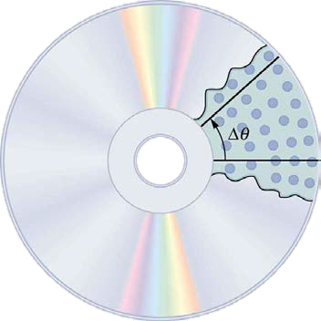

02-06 Angular Velocity and Centripetal Acceleration
Newton’s Laws of motion primarily relate to straight-line motion.
Uniform Circular Motion
  Motion in circle with constant speed
Rotation Angle ($Δθ$)
  Angle through which an object rotates

Slide 63
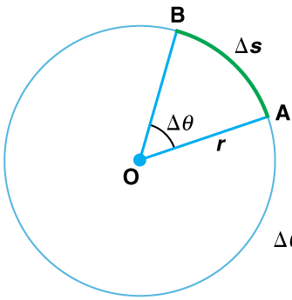

02-06 Angular Velocity and Centripetal Acceleration
Arc Length is the distance around part of circle
$$Δθ=\frac{Δs}{r}$$
Angle Units:
  Revolutions: 1 circle = 1 rev
  Degrees: 1 circle = 360°
  Radians: 1 circle = $2π$
Arc Length formula must use radians and angle unit
$$2π=360°=1 rev$$

Slide 64
02-06 Angular Velocity and Centripetal Acceleration
Convert 60° to radians
Convert 2 revolutions to radians
Notes:
$$\frac{60°}{}\left(\frac{2π}{360°}\right)=\frac{π}{3}$$
$$\frac{2 rev}{}\left(\frac{2π}{1 rev}\right)=4π$$

Slide 65



02-06 Angular Velocity and Centripetal Acceleration
Angular Velocity ($ω$)
    How fast an object rotates
$$ω=\frac{Δθ}{Δt}$$
Unit: rad/s
  CCW +, CW –
$$v=\frac{Δs}{Δt}$$
$$Δθ=\frac{Δs}{r} →Δs=rΔθ$$
$$v=\frac{rΔθ}{Δt}=rω$$

Slide 66
02-06 Angular Velocity and Centripetal Acceleration
A CD rotates 320 times in 2.4 s. What is its angular velocity in rad/s? What is the linear velocity of a point 5 cm from the center?
Notes:
$$θ=320 rev (2π/1 rev) = 640π rad$$
$$t=2.4s$$
$$=θ/t = 640π rad/2.4s = 838 rad/s$$
$$v=rω$$
$$v=\left(0.05 m\right)\left(838\frac{rad}{s}\right)=41.9 m/s$$

Slide 67
02-06 Angular Velocity and Centripetal Acceleration
Make a hypothesis about what will happen. Which path will an object most closely follow when the centripetal force is removed?
A
B
C

Slide 68
02-06 Angular Velocity and Centripetal Acceleration
Put the plate on a flat surface and put a marble in the ridge.
Push the marble in the ridge so that it travels around the plate and then out of the removed section.
What is providing the centripetal force? i.e. what is keeping the marble traveling in a circle?
Perform the test several times and record your results.
Which of Newton’s Laws explains the results?
This would have been more complicated if the object moved in a vertical circle. Why?
Notes:
3. Rim of the plate
4. Straight line (B)
5. 1st
6. Gravity would have pulled it down

Slide 69
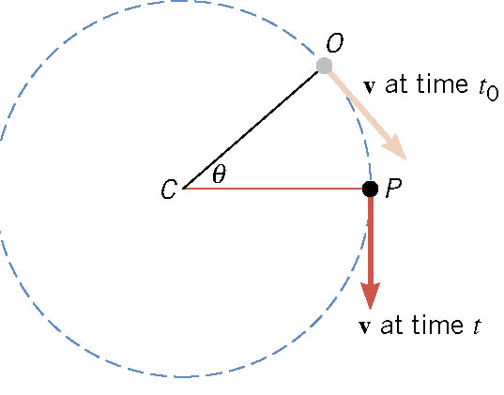
02-06 Angular Velocity and Centripetal Acceleration
Object moves in circular path
At time t₀ it is at point O with a velocity tangent to the circle
At time t, it is at point P with a velocity tangent to the circle
The radius has moved through angle θ

Slide 70
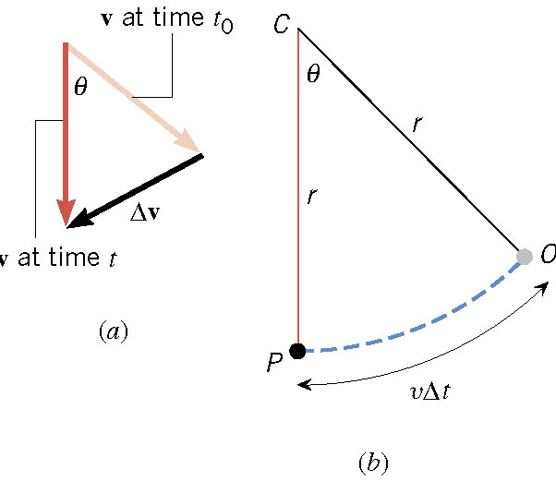
02-06 Angular Velocity and Centripetal Acceleration
Draw the two velocity vectors so that they have the same tails.
The vector connecting the heads is Δv
Draw the triangle made by the change in position and you get the triangle in (b)

Slide 71

02-06 Angular Velocity and Centripetal Acceleration
Since the triangles have the same angle are isosceles, they are similar.
$$\frac{Δv}{v}=\frac{vΔt}{r}$$
$$\frac{Δv}{Δt}=\frac{v^{2}}{r}$$
$$a_{C}=\frac{v^{2}}{r}=rω^{2}$$

Slide 72
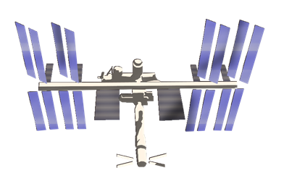
02-06 Angular Velocity and Centripetal Acceleration
At any given moment
  v is pointing tangent to the circle
  a_{c} is pointing towards the center of the circle
If the object suddenly broke from circular motion would travel in line tangent to circle
Notes:
Have a string with something soft on end.
Swing it and let go to illustrate.

Slide 73
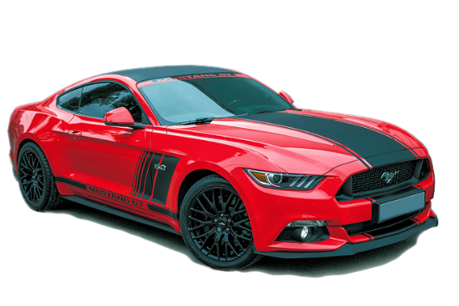
02-06 Angular Velocity and Centripetal Acceleration
Two identical cars are going around two corners at 30 m/s. Each car can handle up to 1 g. The radius of the first curve is 50 m and the radius of the second is 100 m. Do either of the cars make the curve? (hint find the a_{c})
50 m
100 m
Notes:
$$a_{c1}=\frac{v^{2}}{r}→ a_{c1}=\frac{{\left(30 \frac{m}{s}\right)}^{2}}{50 m}→ a_{c1}= 18 \frac{m}{s2}$$
Can’t make it
$$a_{c2}=\frac{{\left(30 \frac{m}{s}\right)}^{2}}{100 m}= 9 \frac{m}{s2}$$
Yes

Slide 74
02-06 Angular Velocity and Centripetal Acceleration
Rotating too fast can make you sick, but these problems won’t.
Read 6.3

Slide 75
02-07 Centripetal Force and Banked Curves
In this lesson you will…
• Calculate coefficient of friction on a car tire.
• Calculate ideal speed and angle of a car on a turn.

Slide 76
02-07 Centripetal Force and Banked Curves
Do the lab on your worksheet
Are force and mass a direct or inverse relation?
Are force and speed a direct or inverse relation?
Are force and radius a direct or inverse relation?
A car will skid when the centripetal force required to make it turn is greater than the force of friction. What are two things the driver could do to lessen the change of a skid in a curve?
Notes:
Direct
Direct
Inverse
$$F=\frac{mv^{2}}{r}$$
Lower speed or bigger radius. Lowering mass will decrease friction, so overall changing mass will not affect the car’s cornering.

Slide 77

02-07 Centripetal Force and Banked Curves
Newton’s 2nd Law
  Whenever there is acceleration there is a force to cause it
$F=ma$
$F_{C}=ma_{C}$
$$F_{C}=\frac{mv^{2}}{r}=mrω^{2}$$

Slide 78
02-07 Centripetal Force and Banked Curves
Centripetal Force is not a new, separate force created by nature!
Some other force creates centripetal force
  Swinging something from a string → tension
  Satellite in orbit → gravity
  Car going around curve → friction

Slide 79
02-07 Centripetal Force and Banked Curves
A 1.25-kg toy airplane is attached to a string and swung in a circle with radius = 0.50 m. What was the centripetal force for a speed of 20 m/s? What provides the F_{c}?
F_{c} = 1000 N
Tension in the string
Notes:
$$F_{C}=\frac{mv^{2}}{r}$$
$$=\frac{\left(1.25 kg\right){\left(20\frac{m}{s}\right)}^{2}}{0.50 m}$$
$$=1000 N$$

Slide 80
02-07 Centripetal Force and Banked Curves
What affects F_{c} more: a change in mass, a change in radius, or a change in speed?
A change in speed since it is squared and the others aren’t.

Slide 81
02-07 Centripetal Force and Banked Curves
When a car travels around an unbanked curve, static friction provides the centripetal force.
By banking a curve, this reliance on friction can be eliminated for a given speed.

Slide 82
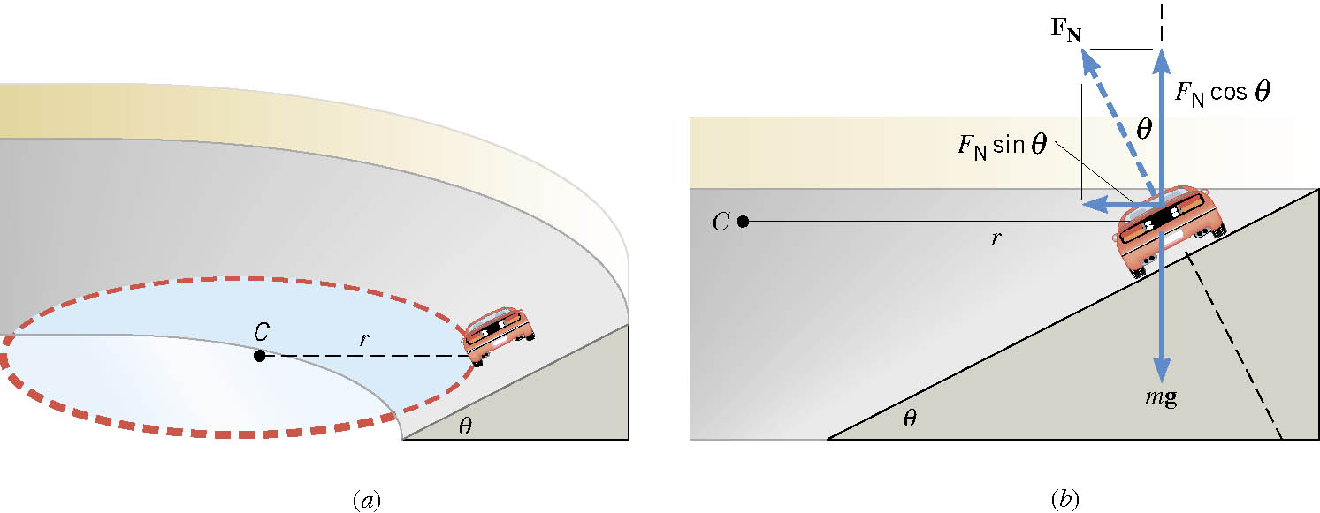

02-07 Centripetal Force and Banked Curves
A car travels around a friction free banked curve
Normal Force is perpendicular to road
  x component (towards center of circle) gives centripetal force
  $$F_{N}\sin{θ}=\frac{mv^{2}}{r}$$
  y component (up) cancels the weight of the car
  $$F_{N}\cos{θ}=mg$$

Slide 83

02-07 Centripetal Force and Banked Curves
Divide the x by the y
$$F_{N}\sin{θ}=\frac{mv^{2}}{r}$$
$$F_{N}\cos{θ}=mg$$
Gives
$$\tan{θ}=\frac{v^{2}}{rg}$$
Notice mass is not involved
Notes:
Ask what happens when go to fast? (slide up and over top of curve)
Ask what happens when go to slow? (slide down curve)

Slide 84
02-07 Centripetal Force and Banked Curves
In the Daytona International Speedway, the corner is banked at 31° and r = 316 m. What is the speed that this corner was designed for?
v = 43 m/s = 96 mph
Cars go 195 mph around the curve. How?
Friction provides the rest of the centripetal force
Notes:
$$\tan{θ}=\frac{v^{2}}{rg} →\tan{31°}=\frac{v^{2}}{\left(316 m\right)\left(9.8\frac{m}{s^{2}}\right)}$$
$$.6009\left(316 m\right)\left(9.8\frac{m}{s^{2}}\right)=v^{2}$$
$$1861 {\left(\frac{m}{s}\right)}^{2}=v^{2}$$
$$v=43 m/s$$

Slide 85
02-07 Centripetal Force and Banked Curves
Why do objects seem to fly away from circular motion?
They really go in a straight line according to Newton's First Law.

Slide 86
02-07 Centripetal Force and Banked Curves
How does the spin cycle in a washing machine work?
The drum’s normal forces makes the clothes to travel in a circle. The water can go through the holes, so it goes in a straight line. The water is not spun out, the clothes are moved away from the water.

Slide 87
02-07 Centripetal Force and Banked Curves
Remember the good old days when cars were big, the seats were vinyl bench seats, and there were no seat belts? Well when a guy would take a girl out on a date and he wanted to get cozy, he would put his arm on the back of the seat then make a right hand turn. The car and the guy would turn since the tires and steering wheel provided the centripetal force. The friction between the seat and the girl was not enough, so the girl would continue in a straight path while the car turned underneath her. She would end up in the guy’s arms.

Slide 88
02-07 Centripetal Force and Banked Curves
There is a real force to make you do these problems.
Read 6.5

Slide 89
02-08 Satellites and Kepler’s Laws
In this lesson you will…
• Explain Earth’s gravitational force.
• Describe the gravitational effect of the Moon on Earth.
• Discuss weightlessness in space.
• State Kepler’s laws of planetary motion.

Slide 90
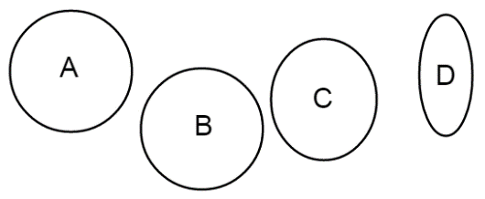
02-08 Satellites and Kepler’s Laws
Do the lab on your worksheet
What effect did moving the pins have on the eccentricity?
The earth’s orbit eccentricity is about 0.0167. One of these ellipses has an eccentricity of 0.0167. Which is it?
Does the ovalness of the earth’s orbit cause the seasons as based on the shape of the earth’s orbit from this lab?
Notes:
Farther apart = more eccentric
B
No

Slide 91
02-08 Satellites and Kepler’s Laws
Satellites
  Any object orbiting another object only under the influence of gravity
  Gravity provides the centripetal force
  There is only one speed that a satellite can have if the satellite is to remain in an orbit with a fixed radius.

Slide 92

02-08 Satellites and Kepler’s Laws
Why only one speed?
$F_{c}=\frac{mv^{2}}{r}$ $F_{g}=\frac{GMm}{r^{2}}$
$\frac{mv^{2}}{r}=\frac{GMm}{r^{2}}$
$$v=\sqrt{\frac{GM}{r}}$$
  r is measured from the center of the earth

Slide 93

02-08 Satellites and Kepler’s Laws
$$v=\sqrt{\frac{GM}{r}}$$
Since 1/r
  As r decreases, v increases
Mass of the satellite is not in the equation, so speed of a massive satellite = the speed of a tiny satellite

Slide 94
02-08 Satellites and Kepler’s Laws
Calculate the speed of a satellite 500 km above the earth’s surface.
Notes:
$$r=500000 m+6.38×{10}^{6} m=6.88×{10}^{6} m$$
$$G=6.67×{10}^{−11}\frac{Nm^{2}}{kg^{2}}$$
$$M=5.98×{10}^{24} kg$$
$$v=\sqrt{\frac{GM}{r}}$$
$$v=\sqrt{\frac{\left(6.67×{10}^{−11}\frac{Nm^{2}}{kg^{2}}\right)\left(5.98×{10}^{24} kg\right)}{6.88×{10}^{6} m}}=7614 m/s$$

Slide 95

02-08 Satellites and Kepler’s Laws
Find the mass of a black hole where the matter orbiting it at r = $2.0×{10}^{20}$ m move at speed of 7,520,000 m/s.
Notes:
$$v=\sqrt{\frac{GM}{r}}$$
$$7520000 \frac{m}{s}=\sqrt{\frac{\left(6.67×\frac{{10}^{−11}Nm^{2}}{kg^{2}}\right)M}{2.0×{10}^{20} m}}$$
$$5.655×{10}^{13}\frac{m^{2}}{s^{2}}=\frac{\left(6.67×{10}^{−11}\frac{Nm^{2}}{kg^{2}}\right)M}{2.0×{10}^{20} m}$$
$$1.131×{10}^{34}\frac{m^{3}}{s^{2}}=\left(6.67×{10}^{−11}\frac{Nm^{2}}{kg^{2}}\right)M$$
$$M=1.70×{10}^{44} kg$$

Slide 96
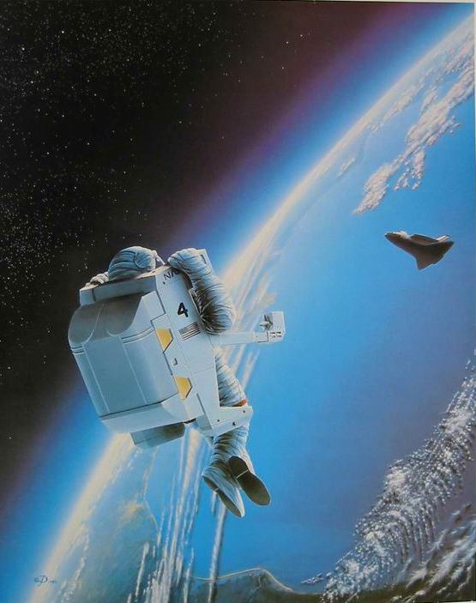
02-08 Satellites and Kepler’s Laws
Astronauts in the space shuttles and international space station seem to float
They appear weightless
They are really falling
  Acceleration is about g towards earth

Slide 97
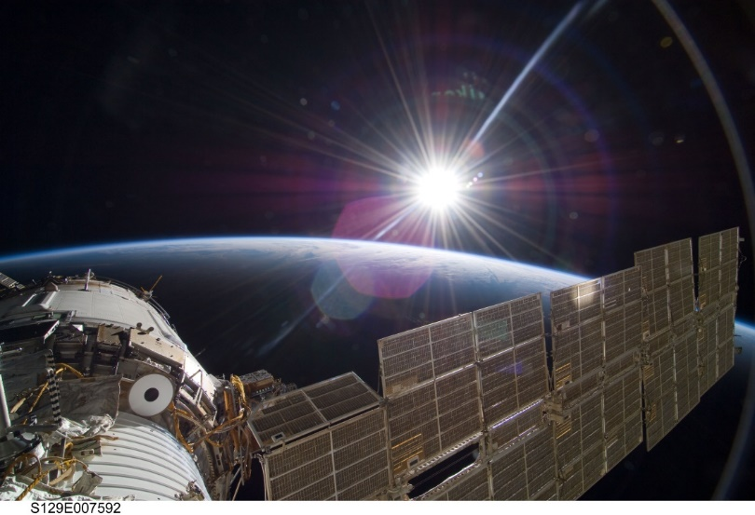
02-08 Satellites and Kepler’s Laws
… they were finally able to close and repressurize the hatch. Several months later a new team of cosmonauts returned and found the hatch impossible to permanently repair. Instead they attached a set of clamps to secure it in place.
It is this set of clamps that Linenger and Tsibliyev are staring at uneasily seven years later. To his relief, the commander opens the hatch Without incident and crawls outside onto an adjoining ladder just after nine o’clock. Linenger begins to follow. Outside the Sun is rising. The Russians have planned the EVA at a sunrise so as to get the longest period of light. But because of that, Linenger’s first view of space is straight into the blazing Sun. “The first view I got was just blinding rays coming at me,” Linenger told his postflight debriefing session. “Even with my gold visor down, it was just blinding. [I] was basically unable to see for the first three or four minutes going out the hatch.”
Notes:
From Dragonfly: NASA and the Crisis Aboard Mir by Bryan Burrough

Slide 98
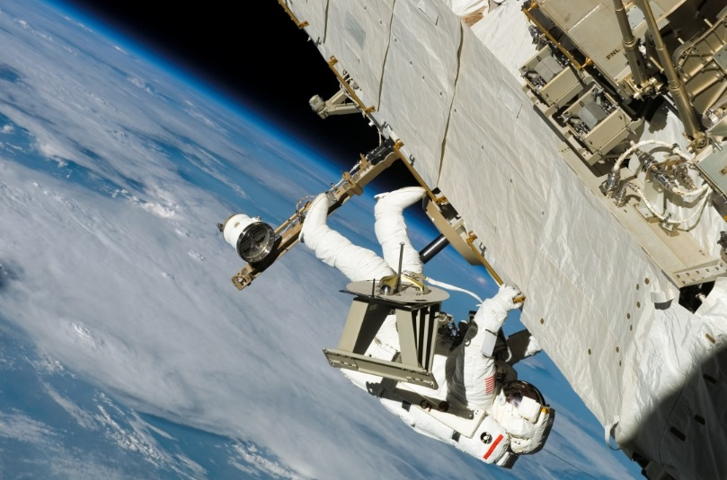
02-08 Satellites and Kepler’s Laws
The situation only gets worse once his eyes clear. Exiting the airlock, Linenger climbs out onto a horizontal ladder that stretches out along the side of the module into the darkness. Glancing about, trying in vain to get his bearings, he is suddenly hit by an overwhelming sense that he is falling, as if from a cliff. Clamping his tethers onto the handrail, he fights back a wave of panic and tightens his grip on the ladder. But he still can’t shake the feeling that he is plummeting through space at eighteen thousand miles an hour. His mind races.
You’re okay. You’re okay. You’re not going to fall. The bottom is way far away.
Notes:
From Dragonfly: NASA and the Crisis Aboard Mir by Bryan Burrough

Slide 99
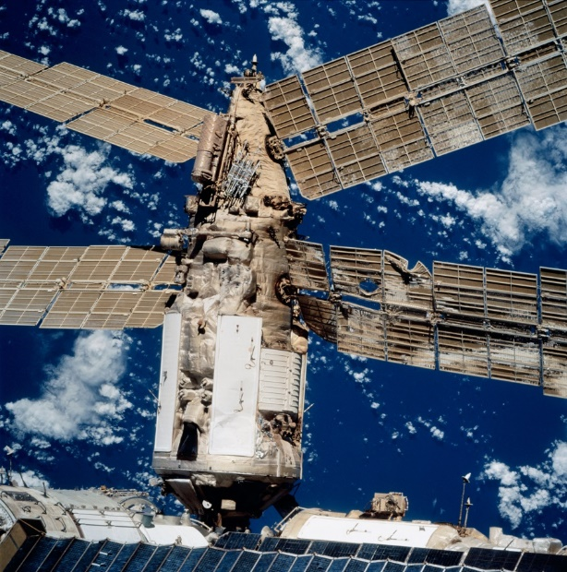
02-08 Satellites and Kepler’s Laws
And now a second, even more intense feeling washes over him: He’s not just plunging off a cliff. The entire cliff is crumbling away. “It wasn’t just me falling, but everything was falling, which gave [me] even a more unsettling feeling,” Linenger told his debriefers. “So, it was like you had to overcome forty years or whatever of life experiences that [you] don’t let go when everything falls. It was a very strong, almost overwhelming sensation that you just had to control. And I was able to control it, and I was glad I was able to control it. But I could see where it could have put me over the edge.”
Notes:
From Dragonfly: NASA and the Crisis Aboard Mir by Bryan Burrough

Slide 100
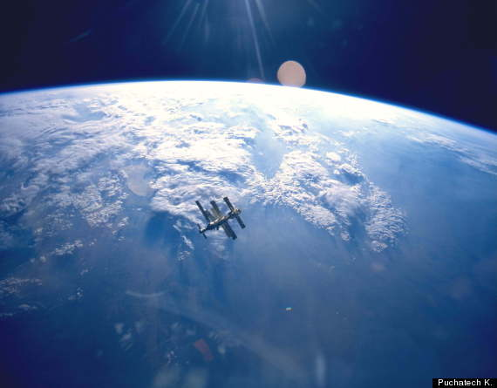
02-08 Satellites and Kepler’s Laws
The disorientation is paralyzing. There is no up, no down, no side. There is only three-dimensional space. It is an entirely different sensation from spacewalking on the shuttle, where the astronauts are surrounded on three sides by a cargo bay. And it feels nothing—nothing—like the Star City pool. Linenger is an ant on the side of a falling apple, hurtling through space at eighteen thousand miles an hour, acutely aware what will happen if his Russian-made tethers break. As he clings to the thin railing, he tries not to think about the handrail on Kvant that came apart during a cosmonaut’s spacewalk in the early days of Mir. Loose bolts, the Russians said.
Loose bolts.
Notes:
From Dragonfly: NASA and the Crisis Aboard Mir by Bryan Burrough

Slide 101
02-08 Satellites and Kepler’s Laws
After studying motion of planets, Kepler came up with his laws of planetary motion
Newton then proved them all using his Universal Law of Gravitation
Assumptions:
  A small mass, m, orbits much larger mass, M, so we can use M as an approximate inertia reference frame
  The system is isolated

Slide 102
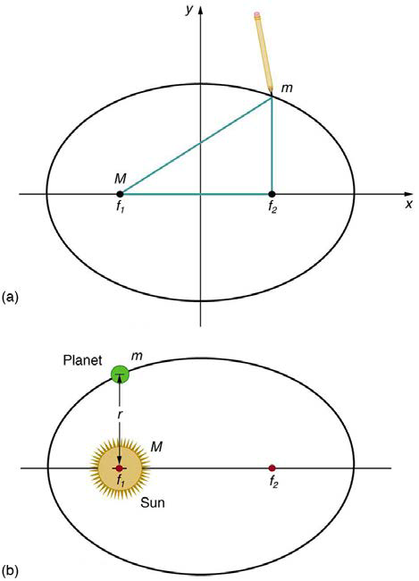
02-08 Satellites and Kepler’s Laws
The orbit of each planet about the Sun is an ellipse with the sun at one focus.
Watch video Kepler’s First Law

Slide 103
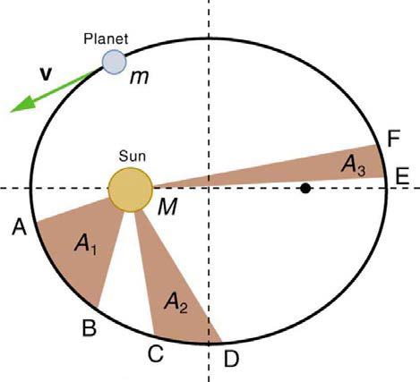
02-08 Satellites and Kepler’s Laws
Each planet moves so that an imaginary line drawn from the sun to the planet sweeps out equal areas in equal times.
Watch video Kepler’s Second Law

Slide 104


02-08 Satellites and Kepler’s Laws
The ratio of the squares of the periods of any two planets about the sun is equal to the ratio of the cubes of their average distances from the sun.
$$\frac{T_{1}^{2}}{T_{2}^{2}}=\frac{r_{1}^{3}}{r_{2}^{3}}$$
These laws work for all satellites
For circular orbits
$T^{2}=\frac{4π^{2}}{GM}r^{3}$ → $\frac{T^{2}}{r^{3}}=\frac{4π^{2}}{GM}$
Table 6.2 gives data about the planets and moons
Notes:
T is period and r is average orbital radius

Slide 105

02-08 Satellites and Kepler’s Laws
Use the data of Mars in Table 6.2 to find the mass of sun.
Mars, $r=2.279×{10}^{8}$ km, $T=1.881$ y
Notes:
$$\frac{T^{2}}{r^{3}}=\frac{4π^{2}}{GM}$$
$$r=2.279×{10}^{8} km=2.279×{10}^{11} m, T=1.881 y=59359845.6 s$$
$$\frac{{\left(59359845.6 s\right)}^{2}}{{\left(2.279×{10}^{11} m\right)}^{3}}=\frac{4π^{2}}{\left(6.673×{10}^{−11}\frac{Nm^{2}}{kg^{2}}\right)M}$$
$$235129.2\frac{m^{3}}{kg} M=4.6730×{10}^{35} m^{3}$$
$$M=1.99×{10}^{30} kg$$

Slide 106
02-08 Satellites and Kepler’s Laws
Draw an ellipse around your answers to these homework problems

